Slide 1
Qupolis
Presenter: Rina Ismailati
Group members: Austin Beller, Phung Cheng Fei

Slide 2


Table Display of Different Backends'
 | IonQ (Azure) | Quantinuum (Azure)
1.circuit depth 2.cx depth 3.cx count, after compilation (opt=2) | 99 33 34 | 99 33 34
1.circuit depth 2.cx depth 3.cx count, after PeepholeOptimise | 43 21 22 | 66 33 34
1.circuit depth 2.cx depth 3.cx count, 2xPeepholeOptimise | 43 21 22 | 46 25 26
 | IBMQ EmulatorBackend | IonQ (AWS Braket) | Rigetti Aspen-11 (AWS Braket) | IBM AerUnitaryBackend
1.circuit depth 2.cx depth 3.cx count, after compilation | 50 19 19 | 41 16 16 | 41 17 19 | 31 17 17
1.circuit depth 2.cx depth 3.cx count, after PeepholeOptimise | 28 16 16 | 30 16 16 | 30 16 16 | 31 17 17
Comments |  |  |  | *no change after PeepholeOptimise

Slide 6
Testing different backends
Circuit Depth:83 CX gates depth:52 CX gates Count:56
Circuit Depth:50% reduction CX gates depth:64% reduction CX gates Count:64 % reduction
Circuit Depth:50% reduction CX gates depth:60% reduction CX gates Count:60% reduction
Circuit Depth:50% reduction CX gates depth:60% reduction CX gates Count:60% reduction
Original
1st IBMQ Emulator Backend
2nd IonQ(AWS)
3rd Rigetti

Slide 7
Error Mitigation
 | Numpy Exact Solver | Two-Local circuit, SLSQP optimizer | Heuristic ansatz, QN-SPSA optimizer
Electronic ground state energy (Hartree) | -1.857275030202 | -1.587190530127 | -1.809530046343
Total ground state energy (Hartree) | -1.137306035753 | -0.867221535678 | -1.089561051894
 | Numpy Exact Solver | Two-Local circuit, SLSQP optimizer | Heuristic ansatz, QN-SPSA optimizer
Electronic ground state energy (Hartree) | -1.857275030202 | -1.857274651021 | -1.857265202892
Total ground state energy (Hartree) | -1.137306035753 | -1.137305656572 | -1.137296208443

Slide 8
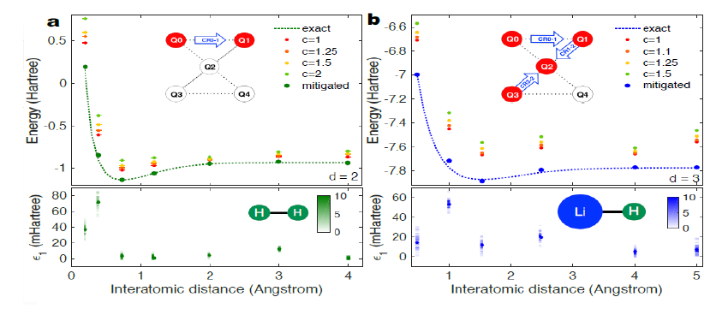
Future Perspectives
We experimented with an identity gate equivalent circuit where we applied the Zero Noise Extrapolation method to find the approximate noiseless expectation value.
In this graph, the authors Kristan Temme, Sergey Bravyi, Jay M. Gambetta have applied the ZNE mitigation technique to receive better accuracy in the variational eigensolver applied to electronic structures of H2 and LiH molecules.

Slide 9
Cost Based Analysis of Backends
Case number | Backend | Time taken | Fidelity | Optimization process | Price Per Shot | Total cost
1 | D-Wave |  |  |  | 0.00019 | 0.0019
2 | IonQ (AWS) |  |  |  | 0.01000 | 0.10
3 | Rigetti |  |  |  | 0.00035 | 0.0035
4 | Quantinium |  |  |  |  | See Subscription details
5 | IBM-Q A |  |  |  | 0.00098 | 0.0098
6 | IBM-Q H |  |  |  | 0.0003 | 0.003
Quantinium Pricing:
Pricing | Standard-$125,000 (USD)/Month + Azure infrastructure costs Premium -$175,000 (USD)/Month + Azure infrastructure costs
Standard | · 10k HQCs for use on the System Model H1 hardware · 100k eHQCs for use on the System Model H1 Emulator
Premium | 17k HQCs for use on System Model H1 hardware 170k eHQCs for use on the System Model H1 Emulato

